Slide 1
A CHATBOT EMOTION DETECTION MODEL FOR MENTAL HEALTH SUPPORT
135861 NICOLE AKINYI OCHIENG
SUPERVISOR : STEPHEN OBONYO

Slide 2
Background and Problem
Mental health constitutes a critical aspect of overall well-being, impacting the lives of millions globally. However, despite increased awareness and advocacy, numerous challenges persist in ensuring widespread access to timely and personalized mental health support
.
Individuals often feel more comfortable using chatbots as a support option due to factors such as anonymity, reduced stigma, convenience, and the availability of immediate assistance.
The absence of robust emotion detection capabilities in mental health support chatbots not only hinders the provision of personalized assistance but also risks overlooking crucial emotional cues, potentially impacting users' mental well-being.
Therefore, the proposed solution aims to bridge this gap by developing an advanced chatbot with integrated emotion detection, providing a more responsive and empathetic mental health support experience.

Slide 3
Motivation
Improving access and availability of mental health support- Provides timely and prompt interventions
Enabling personalized and empathetic chatbot interactions - Chatbots equipped with emotion detection can tailor responses based on the inferred emotional state, rather than a one-size-fits-all approach
Timely identification of users struggling with mental health: Emotion detection provides early clues into users who may be experiencing psychological distress or mental health issues.
Promoting self-monitoring and awareness for mental wellness- : When chatbots reflect and validate user emotions, it can promote self-reflection and awareness for users to manage their own mental health.

Slide 4
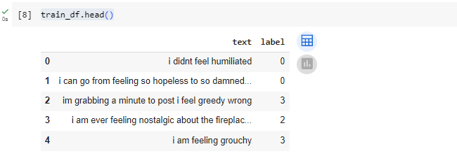
Overview
Dataset Overview – The dataset was derived from hugging face and it constituted of a text with corresponding emotion label. The emotions label were encoded with 0 representing sadness, 1 representing joy, 2 representing love, 3 representing anger, 4 representing fear and 5 representing surprise.

Slide 5
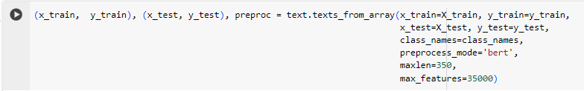
Overview
Data Preprocessing – There was tokenization whereby the data was tokenized and encoded using the Bert tokenizer. The texts were also padded to have the same length . The texts were then converted into Bert input format which consists of attention masks and type ids.

Slide 6
Overview
Model Training- The fitonecycle method trained the model for 2 epochs with early stopping checks to prevent overfitting.
Validation – The model was validated on test data. This enabled to assess how well the model generalised to unseen data. The model achieved a validation accuracy of 0.85

Slide 7
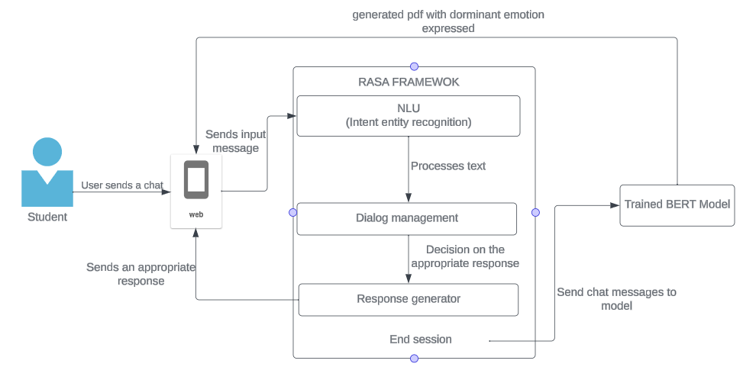
Designed Solution

Slide 8
DEMO

Slide 9
Thanks!

